Slide 1

Dask: Unlocking Parallel Computing for Big Data
Nguyễn Phạm Việt Quang - 22028134
Phạm Tiến Sơn - 22024531

Slide 2
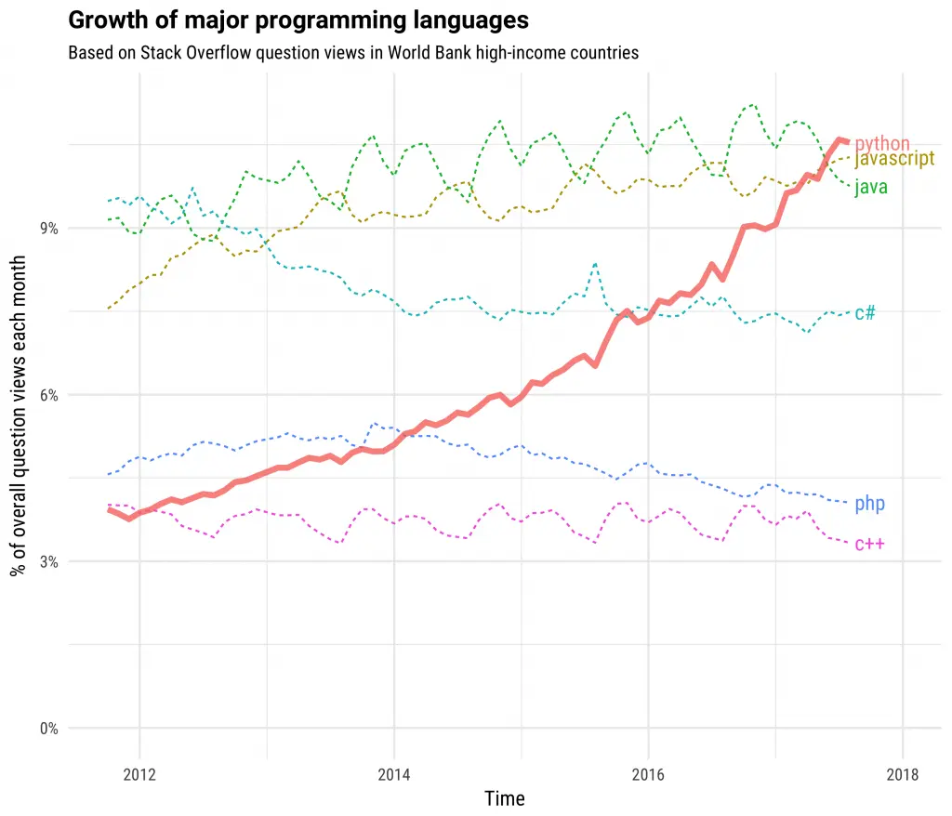
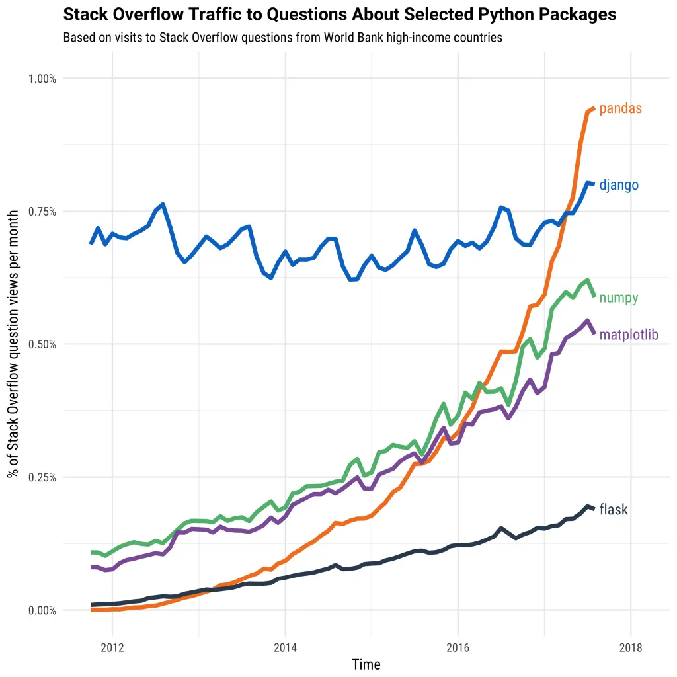
Python is large and growing

Slide 3
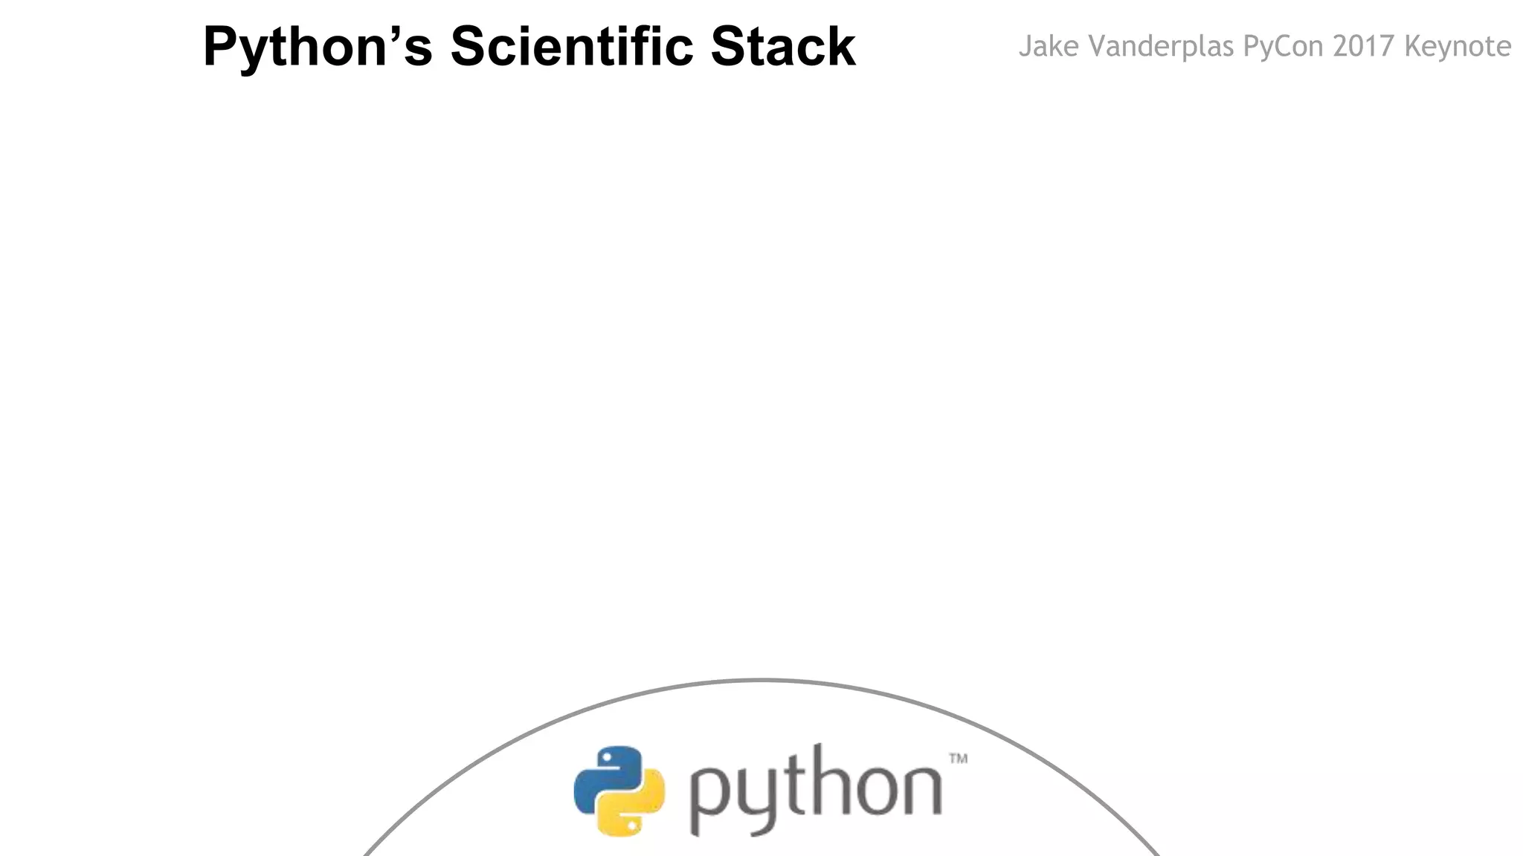

Slide 4
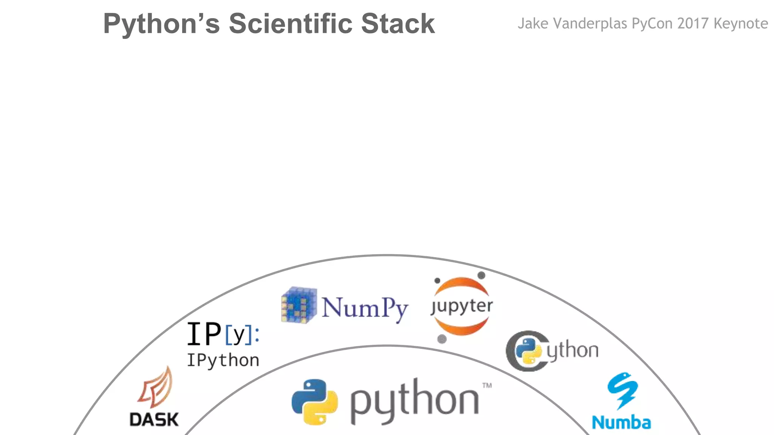

Slide 5
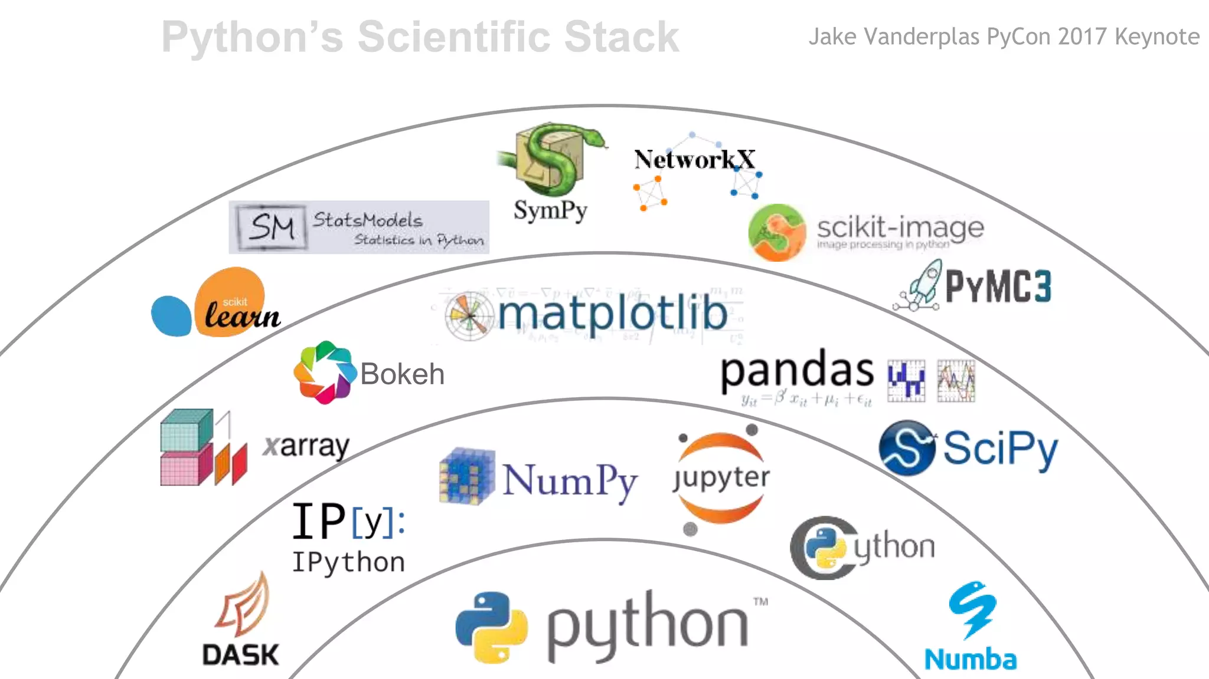

Slide 6
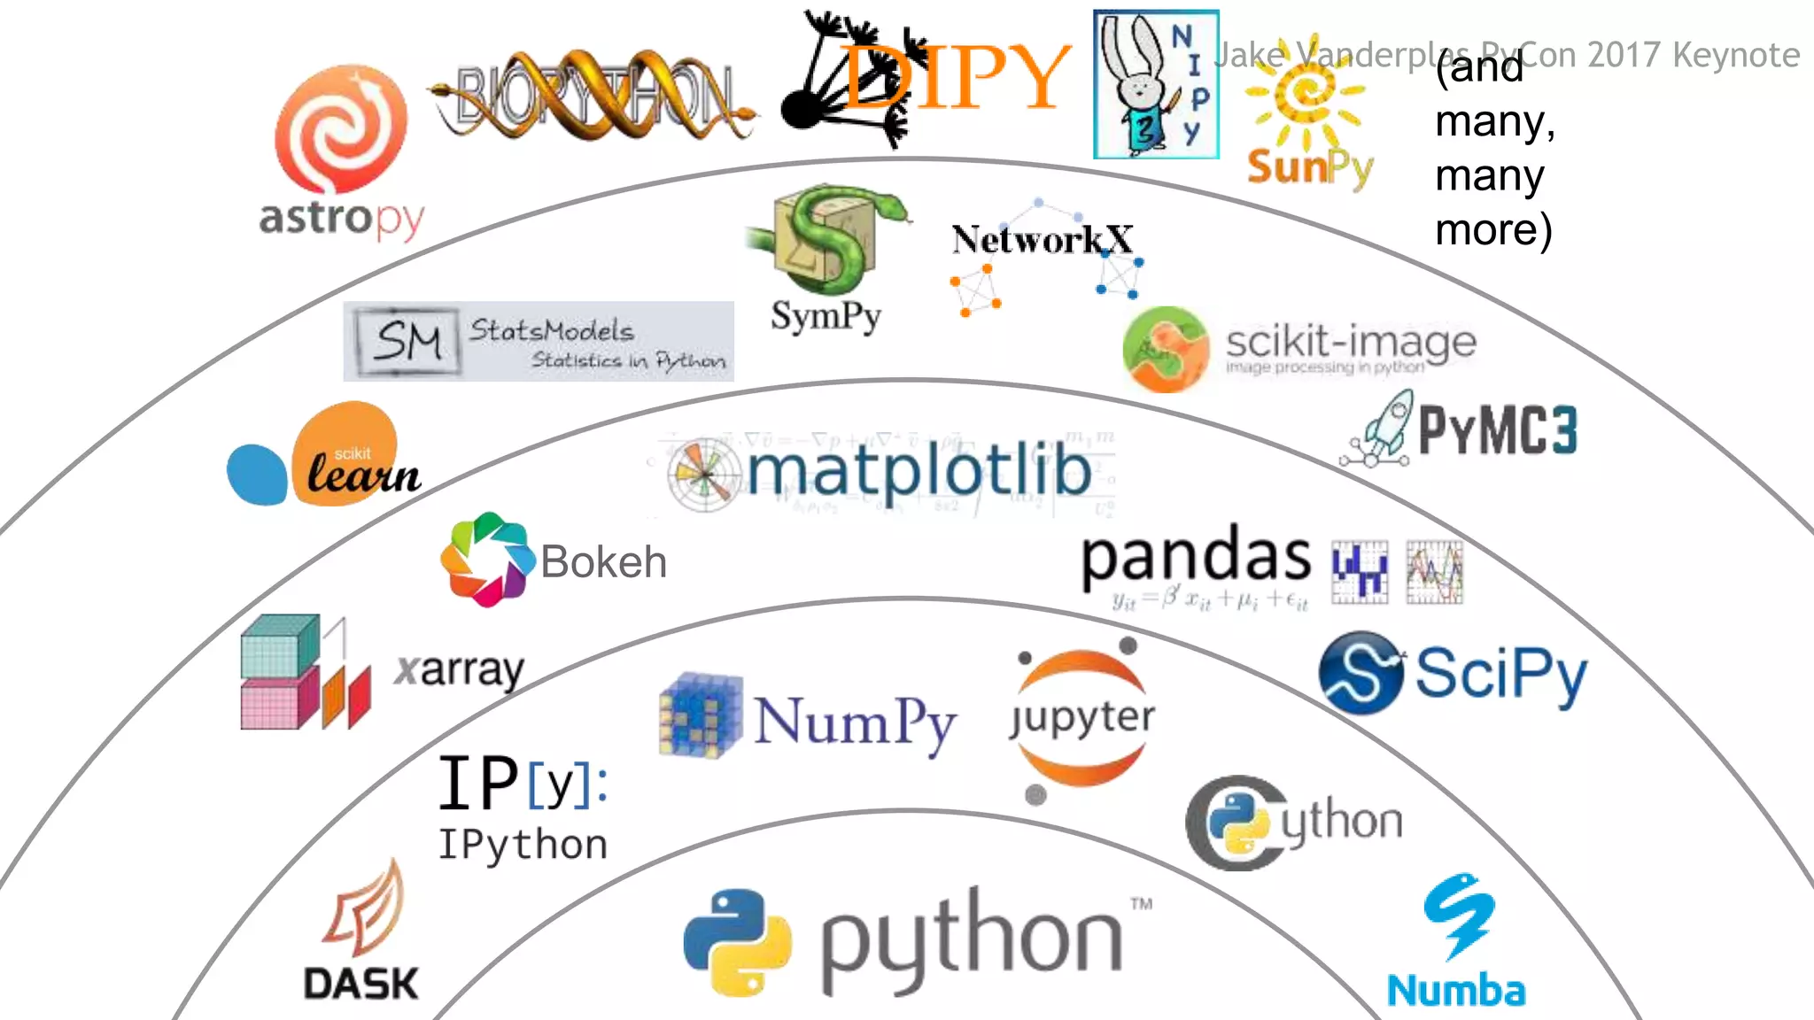

Slide 7

Parallel Computing: DASK offers a flexible parallel computing paradigm, making it suitable for a variety of tasks.
Python Ecosystem: It provides familiar APIs for Python users and is co-developed with teams from Pandas, SKLearn, and Jupyter.
Scalability: DASK scales from multicore systems to 1000-node clusters, ensuring resilience, responsiveness, and real-time capabilities.

Slide 8
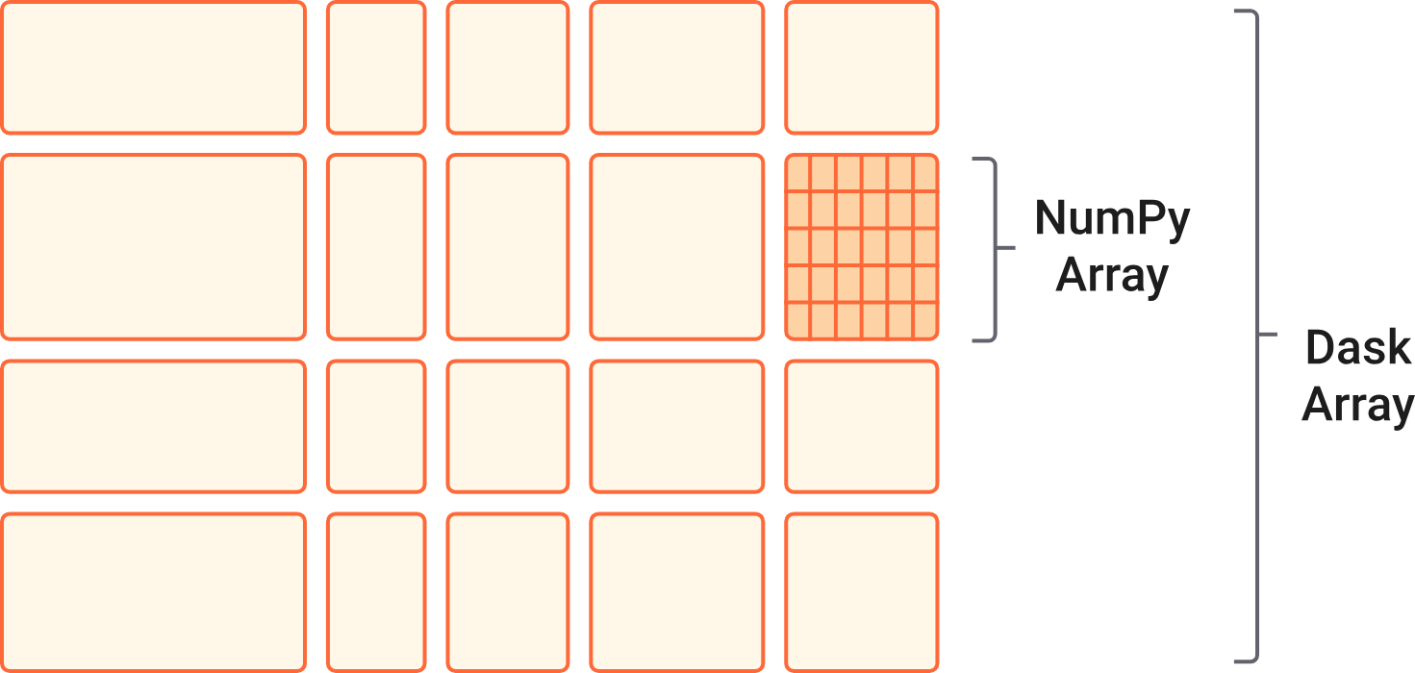
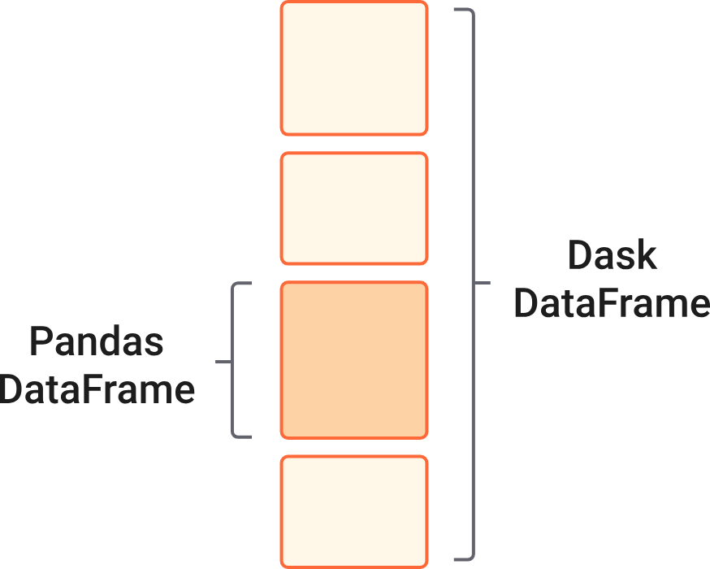
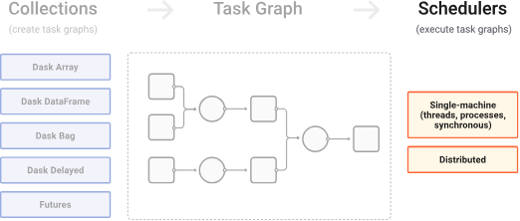
About Dask
High Level: Parallel NumPy, Pandas, ML
Satisfies subset of these APIs
Uses these libraries internally
Co-developed with these teams
Low Level: Task scheduling for arbitrary execution
Parallelize existing code
Build novel real-time systems
Arbitrary task graphs with data dependencies
Same scalability

Slide 9



Why choose Dask?
Familiar with Python:
Drop-in NumPy/Pandas/SKLearn APIs
Native memory environment
Easy debugging and diagnostics
Have complex problems:
Parallelize existing code without expensive rewrites
Sophisticated algorithms and systems
Real-time response to small-data
Scales up and down:
Scales to 1000-node clusters
Also runs cheaply on a laptop

Slide 10
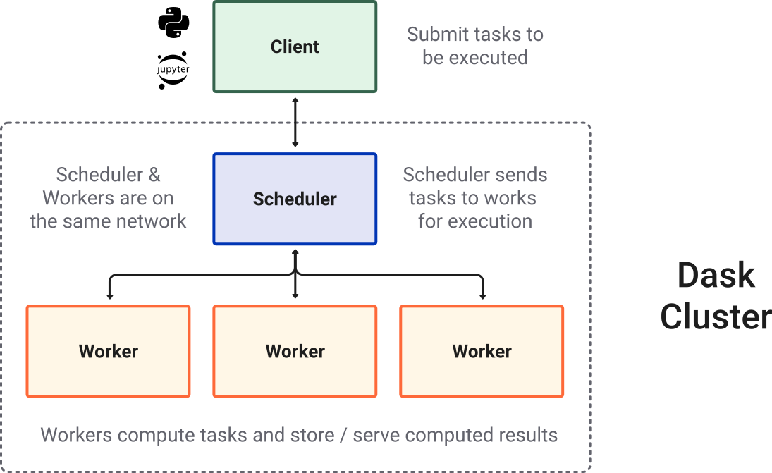
Dask Cluster
Most of the times when you are using Dask, you will be using a distributed scheduler, which exists in the context of a Dask cluster.

Slide 11
Dask Dataframe
The Dask Dataframe module implements a “blocked parallel” DataFrame object that looks and feels like the pandas API, but for parallel and distributed workflows.
One Dask DataFrame is comprised of many in-memory pandas DataFrames separated along the index.
One operation on a Dask DataFrame triggers many pandas operations on the constituent pandas DataFrames in a way that is mindful of potential parallelism and memory constraints.

Slide 12
Dask Arrays
Parallel, larger-than-memory, n-dimensional array using blocked algorithms.
Dask Array implements a subset of the NumPy ndarray interface using blocked algorithms, cutting up the large array into many small arrays, which compute on arrays larger than memory using all of our cores.

Slide 13
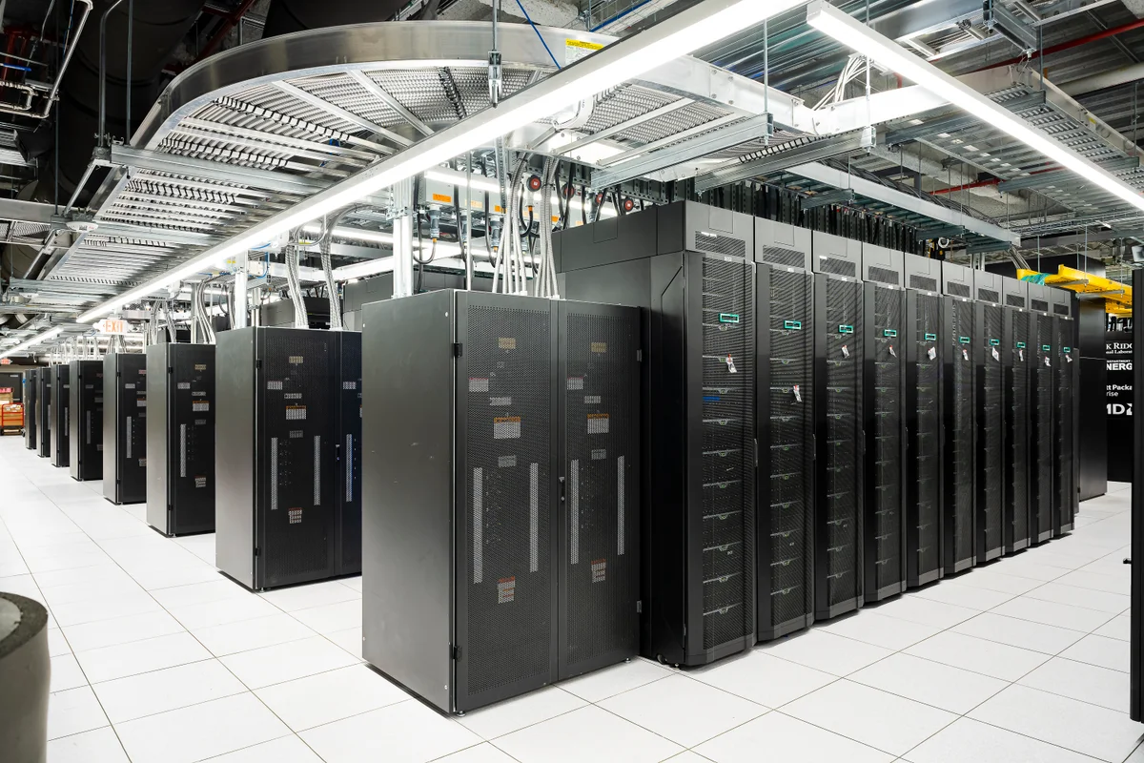
Dask Scalability
Dask Scales Up:
Supports thousand-node clusters including cloud computing and supercomputers.
Offers gigabyte/s bandwidth and 200 microsecond task overhead.
Dask Scales Down:
Operable in a single Python thread pool.
Minimal performance penalty, measured in microseconds.
Lightweight:
Few dependencies
Easy install

Slide 14
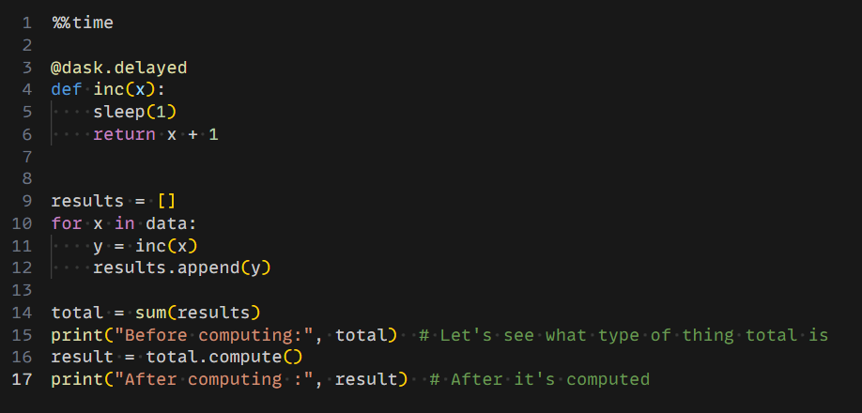
Dask Delayed - parallelize any code
What if you don’t have an array or dataframe?
Instead of having blocks where the function is applied to each block, you can decorate functions with @delayed and have the functions themselves be lazy.
This is a simple way to use dask to parallelize existing codebases or build complex systems.

Slide 15
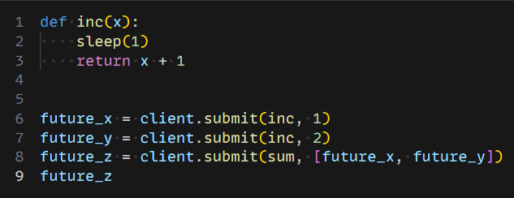
Dask Future - non-blocking distributed calculations
Submit arbitrary functions for computation in a parallelized, and non-blocking way.
We can submit individual functions for evaluation with one set of inputs, or evaluated over a sequence of inputs with submit() and map(). The call returns immediately, giving one or more futures, whose status begins as “pending” and later becomes “finished”. There is no blocking of the local Python session.
This is the important difference between futures and delayed. Both can be used to support arbitrary task scheduling, but delayed is lazy (it just constructs a graph) whereas futures are eager. With futures, as soon as the inputs are available and there is compute available, the computation starts.

Slide 16
Comparison
Pandas
Works well with small to medium sized data (fits in memory)
Single threaded, does not take advantage of multi-core CPUs
Fast processing with small files, but prone to memory errors with large files
Dask
Task scheduler-worker model, tailored for Python data analysis and machine learning workflows.
Python-centric data analysis and machine learning, seamlessly integrates with Python libraries.
Growing within the Python ecosystem, benefits from Python's rich libraries and tools.

Slide 17
Demo Performance Comparison: Pandas vs Dask

Slide 18
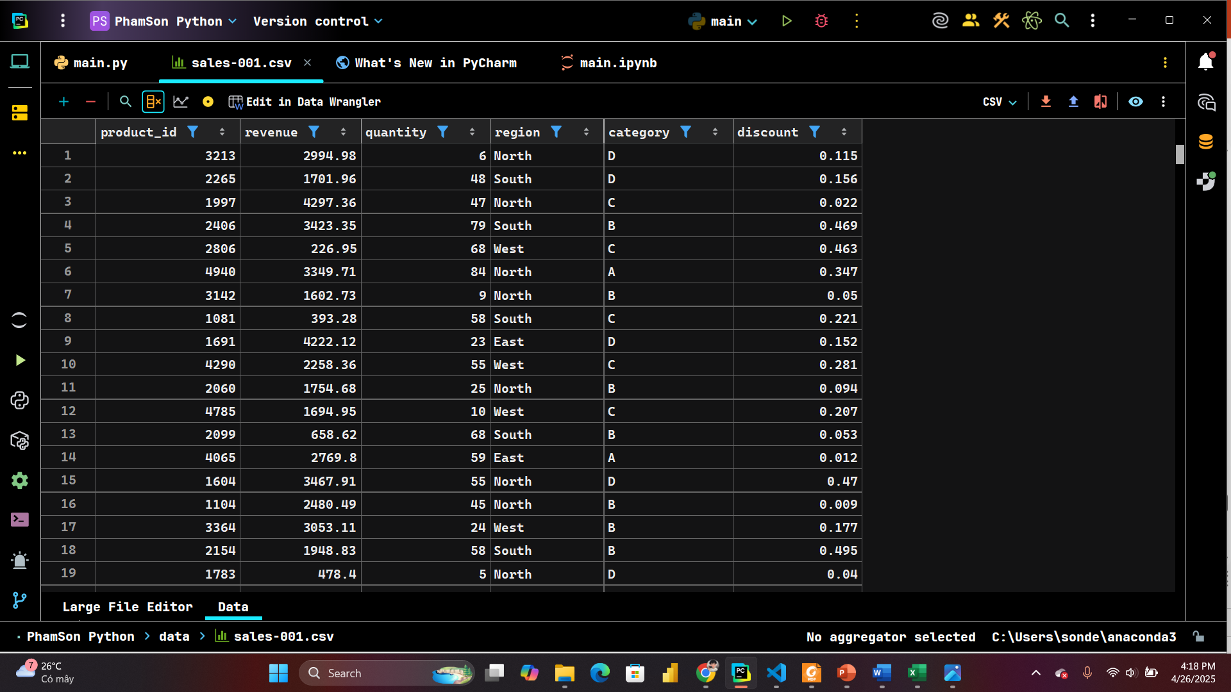


Problem: Processing a large sales dataset (~10GB).
Data includes:
Product ID
Revenue
Quantity
Region
Category
Discount
Request:
Average the revenue over the entire data set and Performance comparison between Pandas vs Dask.

Slide 19
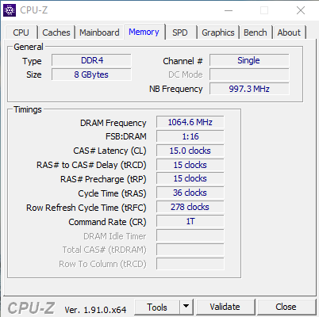
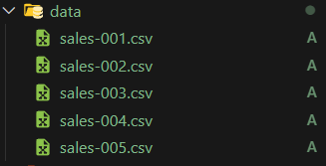
Challenges
Data is larger than RAM capacity
Total: 10GB CSV > 8GB RAM

Slide 20
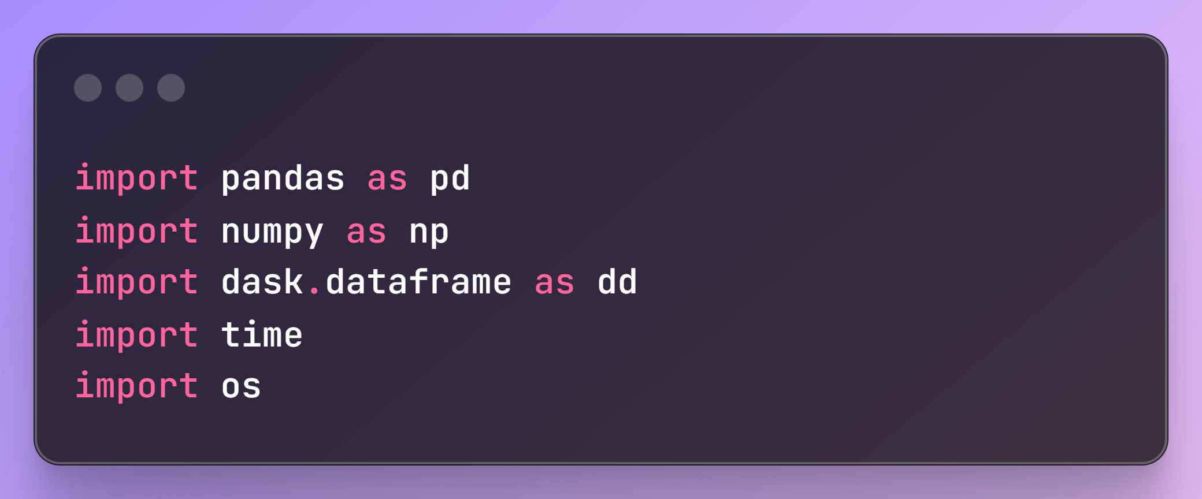
Preparing for solutions
Library – Dask, Pandas, Numpy (for create random datasets), time

Slide 21
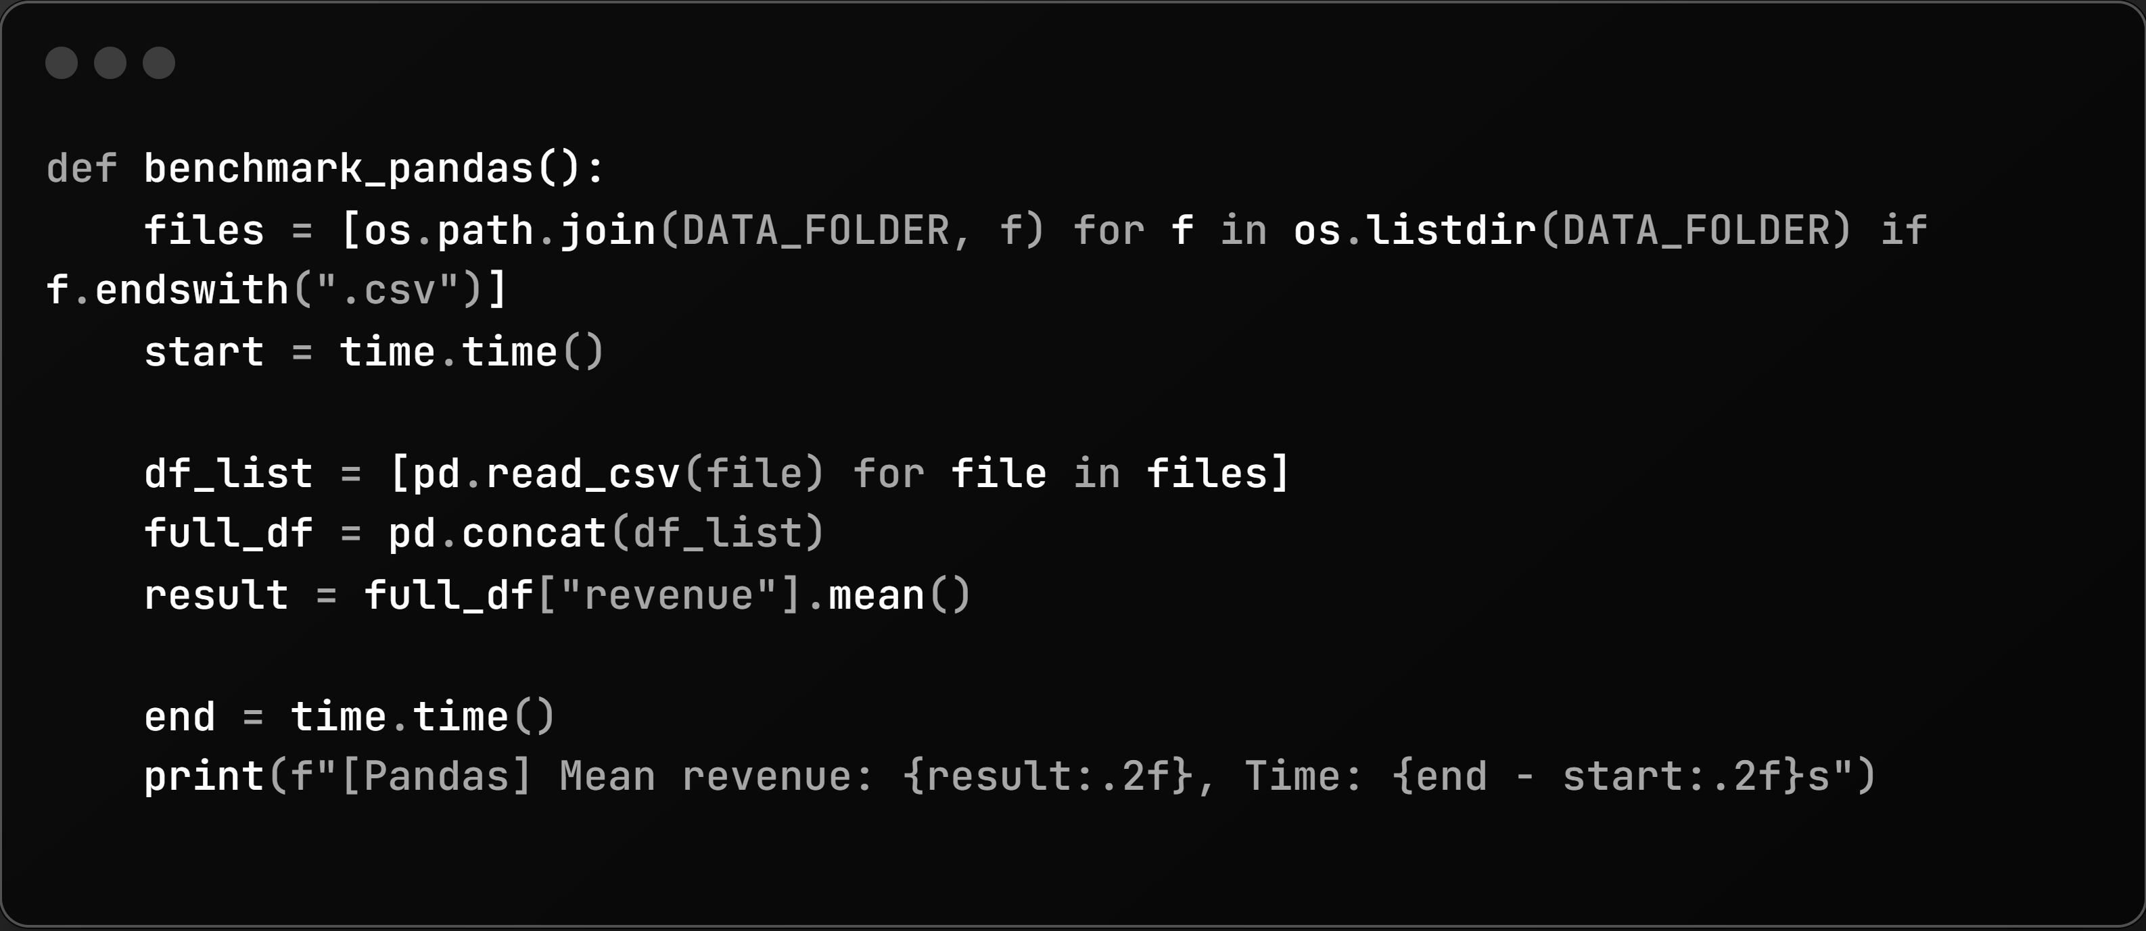
Pandas

Slide 22
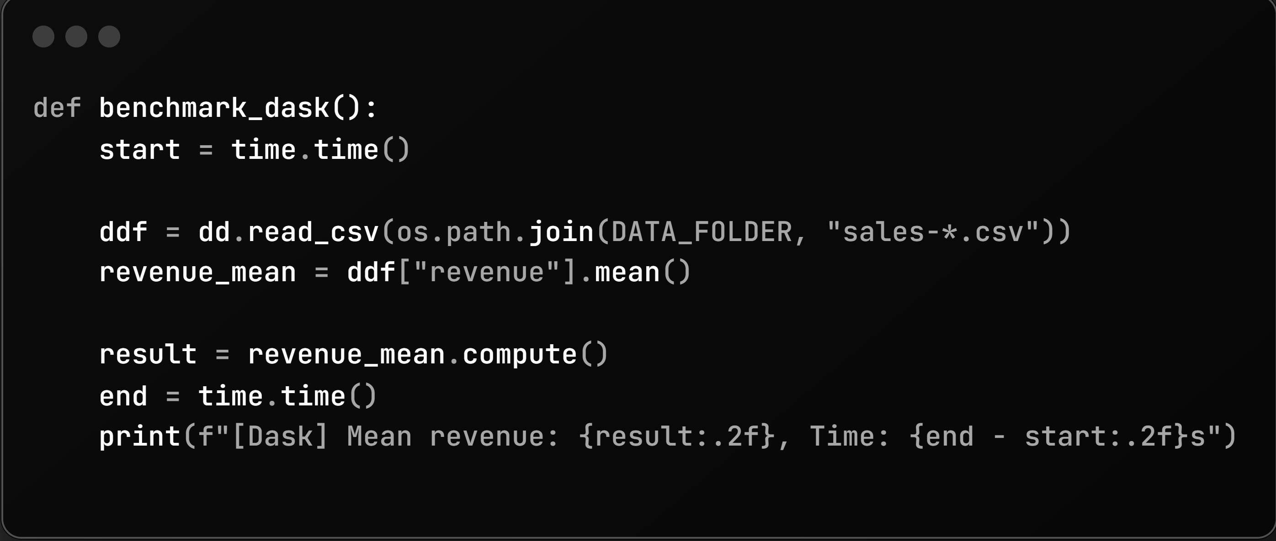
Dask

Slide 23
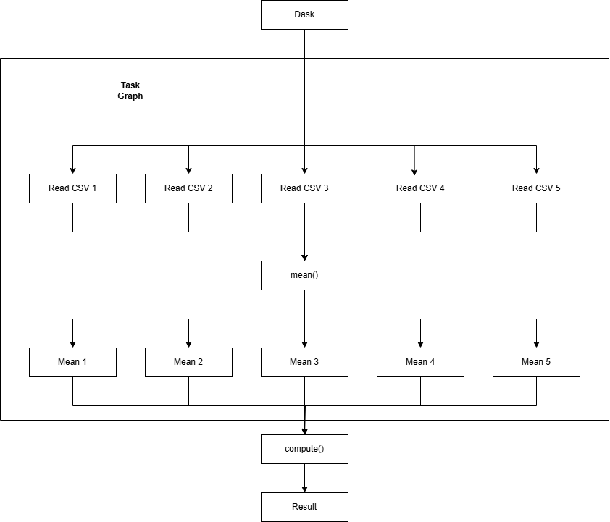
Task Graph

Slide 24
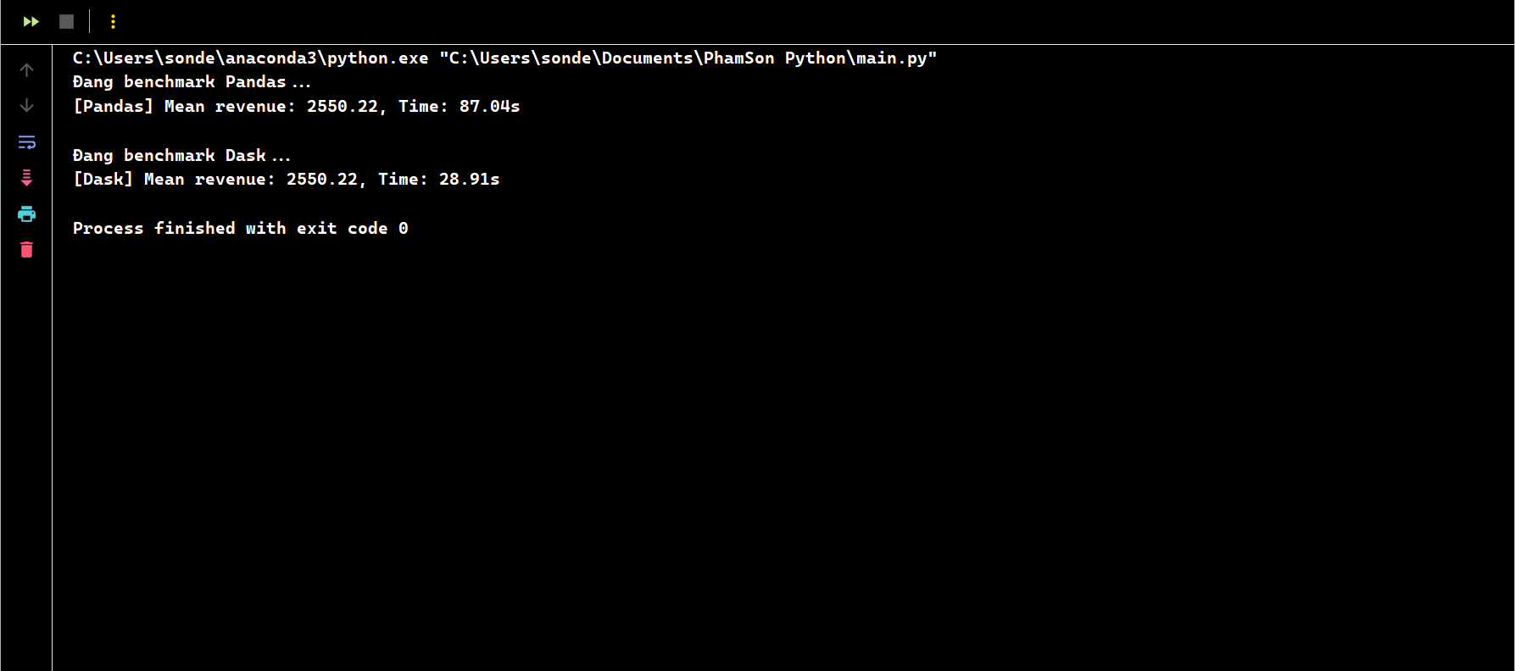
Benchmark Results & Time Compare

Slide 25
Key Observations
Pandas works well with small and medium sized data.
When CSV/Data file size > 50–70% of actual RAM → starts to get MemoryError or run extremely slow.

Slide 26
Thank you!

Slide 27
Q&A

